Slide 1
Biology
Sylvia S. Mader
Michael Windelspecht
Chapter 22
Fungi Evolution and Diversity
Lecture Outline
Copyright 2022 © McGraw Hill LLC. All rights reserved. No reproduction or distribution without the prior written consent of McGraw Hill LLC.

Slide 2
Outline
22.1 Evolution and Characteristics of Fungi
22.2 Diversity of Fungi
22.3 Symbiotic Relationships of Fungi

Slide 3
22.1 Evolution and Characteristics of Fungi
The fungi are classified in supergroup Opisthokonta and include over 140,000 species
Fungi consist mostly of multicellular eukaryotes that share a common mode of nutrition
    Heterotrophic and saprotrophic
      Cells release digestive enzymes that break down and then absorb resultant nutrient molecules

Slide 4
Evolution of Fungi
Classification of fungal phyla is ongoing and incomplete
Recent studies have determined the previously identified groups are not monophyletic
Six groups are currently recognized

Slide 5
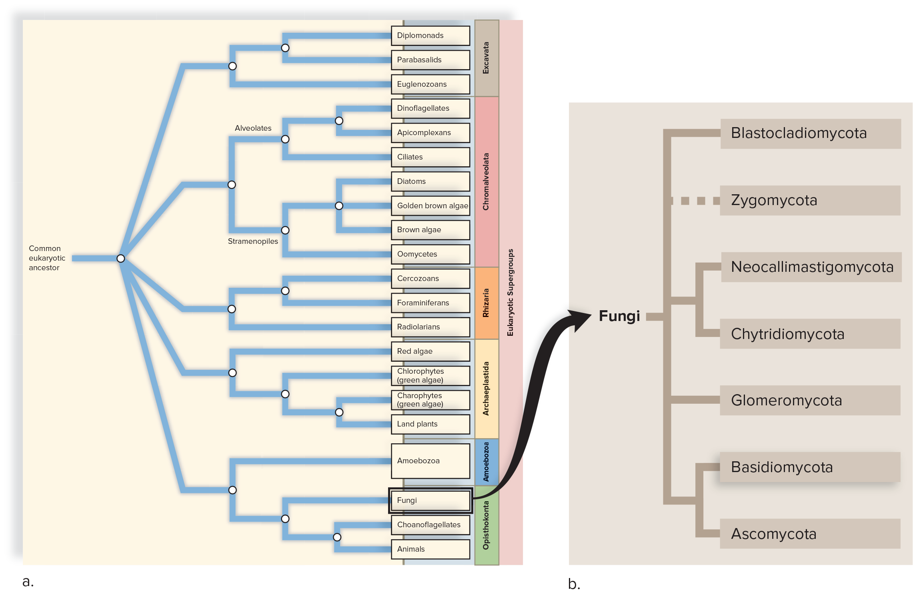
Evolutionary Relationships Among the Fungi
Figure 22.1
Access the text alternative for slide images.

Slide 6
Evolution of Protists
Protists evolved some 1.5 Billion Years Ago (BYA)
  Plants, animals, and fungi trace their ancestry to protists
  Molecular data tells us that animals and fungi shared a more recent common ancestor than animals and plants
    A flagellated, unicellular protist was most likely the common ancestor of fungi and animals
    Multicellular forms evolved after animals and fungi split into two different lineages

Slide 7
Fossils and Fungi
Fungal anatomy doesn’t lend itself to becoming fossilized
    It probably evolved a lot earlier than the earliest known fungal fossil dated 460 MYA
    Mycorrhizae are evident in plant fossils
      Fungi may have been instrumental in colonization of land by plants

Slide 8
Structure of Fungi
  Body (thallus) of most fungi is a multicellular mycelium (yeasts are unicellular)
    Consists of a vast network of thread-like hyphae
      Hyphae give the mycelium a large surface area to maximize absorption
      Some fungi have septate hyphae
        Septa, are porous cross walls that partition hyphae into individual cells
        Pores allow cytoplasm and other materials to pass easily from cell to cell
      Some fungi have aseptate hyphae
        Hyphae are multinucleated because they are not partitioned into cells
  Fungal cell walls composed of chitin, like insect exoskeletons
  Excess food is stored as glycogen as in animals

Slide 9
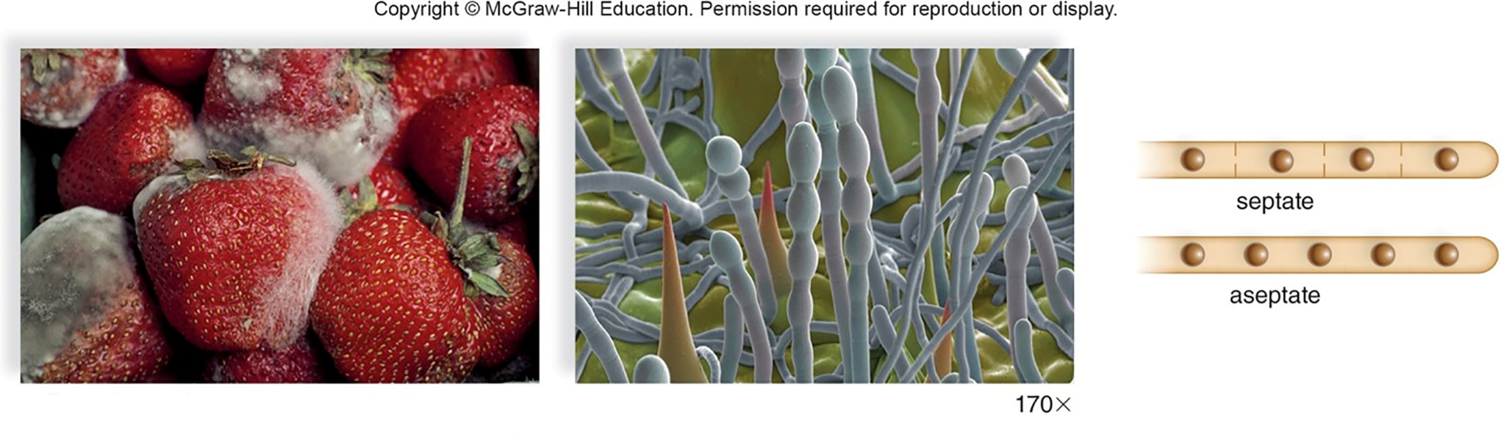
Mycelia and Hyphae of Fungi
Figure 22.2
(a): Matt Meadows/Photolibrary/Getty Images; (b): Andrew Syred/Science Source

Slide 10
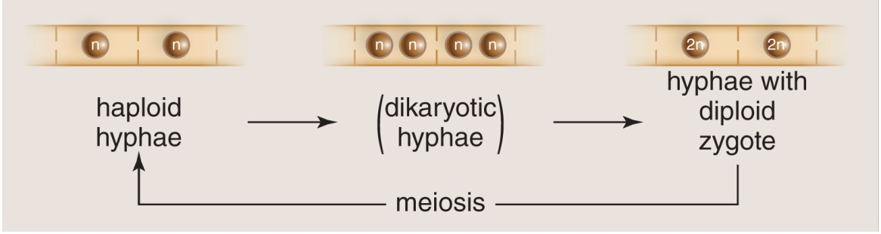
Reproduction of Fungi
    Both sexual and asexual reproduction occur in fungi
      Sexual reproduction involves three stages:
        Haploid Hyphae
        Dikaryotic Stage (two nuclei)
        Diploid Zygote

Slide 11
Sexual Reproduction of Fungi
During sexual reproduction, hyphae from two different mating types fuse
    Hyphae that contain paired haploid nuclei are said to be dikaryotic
    Nuclear fusion produces a diploid nucleus, which produces haploid spores by meiosis
    Spores germinate directly into haploid hyphae without embryological development

Slide 12
Terrestrial Fungi
Terrestrial fungi usually produce nonmotile spores:
    Reproductive cell that develops into a new organism without the need to fuse with another reproductive cell
Asexual reproduction usually involves the production of windblown spores
  Large mushroom can produce billions of spores in a few days
  When a spore lands on an appropriate food source it germinates and grows
Unicellular yeasts reproduce asexually by budding
    Small cell forms from a parent cell and eventually is pinched off

Slide 13
22.2 Diversity of Fungi
In 1969, R. H. Whittaker classified fungi as a separate group from protists, plants, animals, and photosynthetic organisms
    His reasoning was that fungi are the only type of multicellular organism to be saprotrophic
  Currently, fungi are thought to be the closest multicellular relative of animals
    Fungi and animals classified in supergroup Opisthokonta
  Phylogenetic relationships among fungi have been the cause of much debate
    Understanding of fungal phylogeny is going through many revisions based on molecular sequence data

Slide 14
Features of the Fungi Phyla
Table 22.1 Features of the Fungi Phyla
Fungal Lineage | Characteristics
Blastocladiomycota | Contains zoospores and can exhibit an alternation-of-generations life cycle similar to plants
Zygomycota | Contain hyphae without septa. Sexual spores are called zygospores. Most commonly associated with species that produce black bread mold.
Neocallimastigiomycota | Fungi with no mitochondria. Use araerobic metabolism to grow in the guts of herbivores Zoospores found in their life cycle
Chytridiomycota | Aquatic single-celled fungi wth zoospores. Can be animal parasites.
Glomeromycota | Form arbuscular mycorrhizae
Ascomycota | Asexual reproduction on conidiophores and terual reproduction in a fruiting body called an ascus
Basidiomy cota | Possesses the most commonly recognized fruiting bodies (Le mushrooms, puffball with haploid spores called basidiospores
Table divided into two columns summarizes features of the fungi phyla. The column headers are: Fungal lineage and characteristics.

Slide 15
Microsporidia Are Parasitic Fungal Relatives
It is unclear how microsporidians fit within kingdom Fungi
  Currently, they are considered a “sister group” to fungi
Microsporidia are single-celled, obligate, intracellular animal parasites
    Biologists used to think they were an ancient line of protist
E. cuniculi and other microsporidia cause diseases in immunocompromised patients
  Microsporidians infect hosts with spores, which infect intestinal or neuronal cells

Slide 16
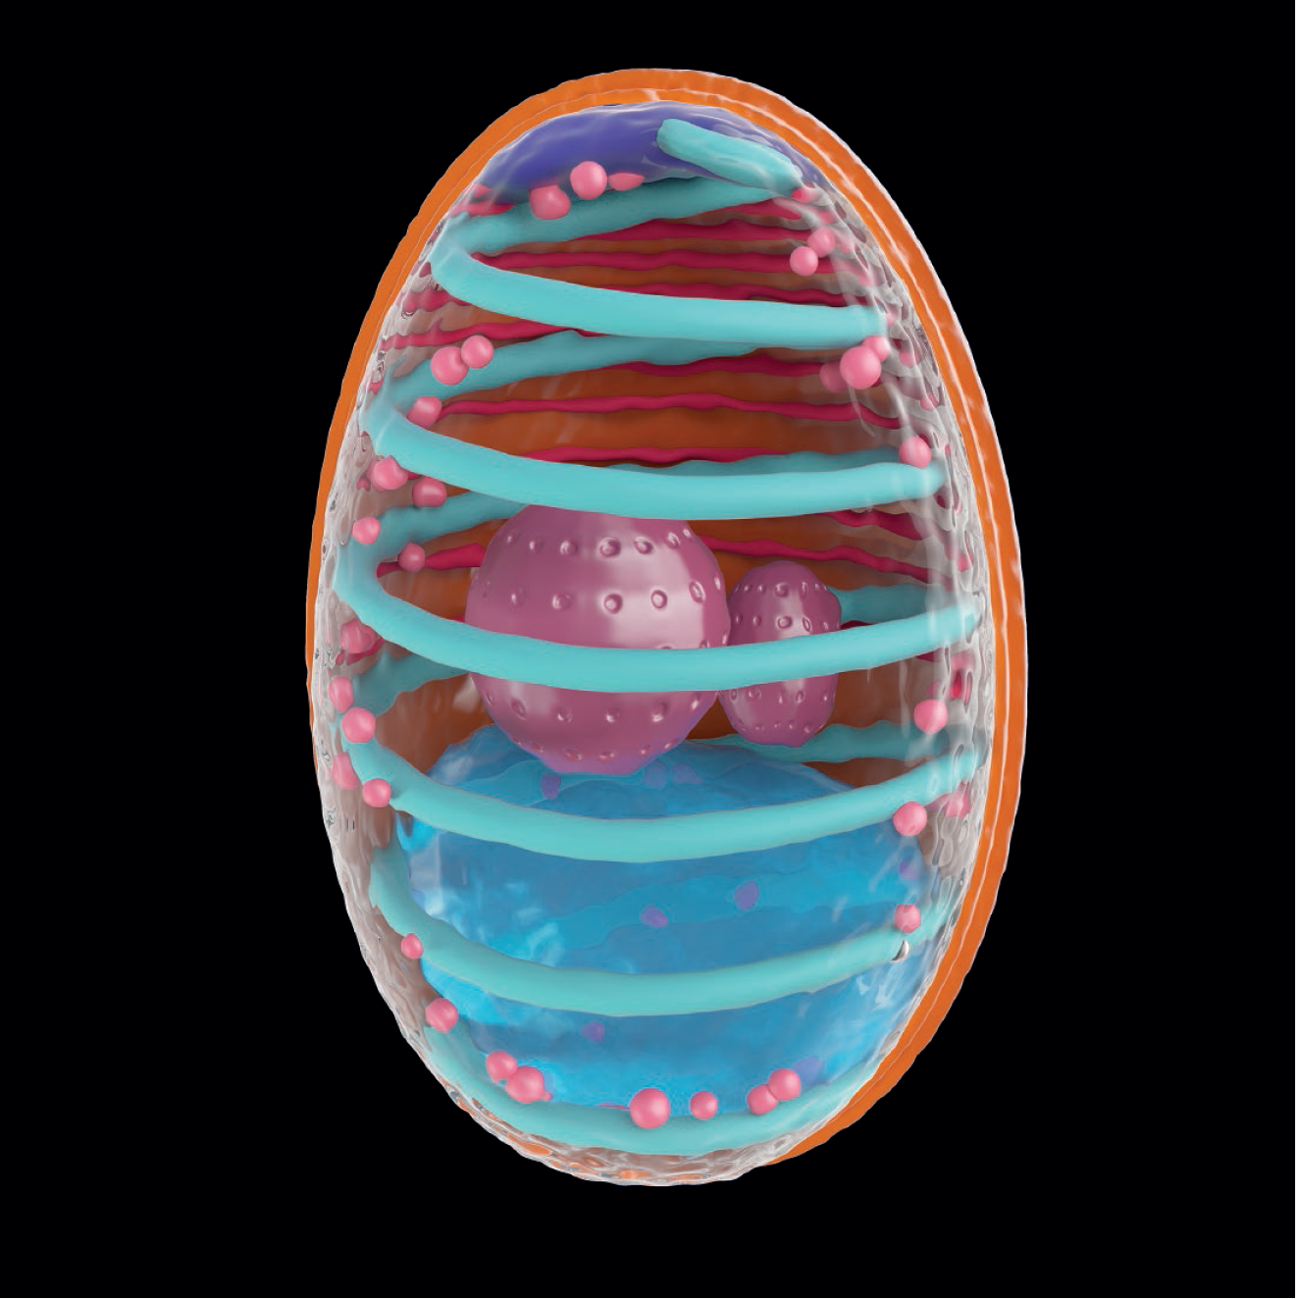
Illustration of the Infectious Spore of Microsporidium Encephalitozoon cuniculi
Figure 22.3
SciePro/Shutterstock

Slide 17
Fungi with Zoospores
Zoospore is an asexual spore with a flagellum
  Spore can swim in moist soil or aquatic environments until it lands on a substrate and germinates
  Placement of the flagella in their spores suggests a shared ancestry of fungi and choanoflagellates
  Three phyla of true fungi with zoospores: Blastocladiomycota, Neocallimastigomycota, and Chytridiomycota

Slide 18
Blastocladiomycota
Blastocladiomycetes, also known as blastoclads, are found in terrestrial or aquatic environments
All members produce asexual zoospores and some species will also exhibit an alternation-of-generations life cycle similar to plants
Many blastocads are parasites of plants, invertebrates, and algae
  Physoderma maydis, is a plant pathogen that causes brown spot and stalk rot on corn
    Spore-producing structures called sporangia remain dormant in the soil and are wind dispersed onto the leaves of a corn plant
    If plant gets wet, the sporangia produce zoospores that swim and infect the young tissues of developing plants

Slide 19
Neocallimastigomycota
Neocallimastigomycetes lack mitochondria, are anaerobic, and live exclusively in the guts of ruminants and other herbivores
Ruminants, like sheep and cows, and nonmammalian herbivores like some lizards, depend on these fungi to enzymatically break down cellulose and lignin
  Without these fungi, these animals would not be able to obtain sufficient nutrition and calories from their plant-based diets
The genome of Neocallimastix has genes that code for digestive enzymes that originally were present in bacteria
  The genes were obtained through horizontal gene transfer, a method of sharing DNA between unrelated species
Due to the anaerobic growth of these fungi and their abilities to degrade cellulose at relatively high temperatures, they have potential uses in biotechnology for biofuel production

Slide 20
Chytridiomycota
Chytrids include the simplest fungi, which may resemble the first fungi to have evolved
Some chytrids are single cells; others form branched aseptate hyphae
Most reproduce asexually through production of zoospores
Chytrids play a role in decay and digestion of dead aquatic organisms, but some are parasites of living plants, animals, and protists
  Parasitic chytrid Batrachochytrium dendrobatidis has decimated populations of over 200 species of frogs, resulting in a large loss of amphibian biodiversity
  Chytrid infects frog’s skin; ultimately inhibits oxygen and water intake; electrolyte imbalances result in cardiac arrest, death

Slide 21
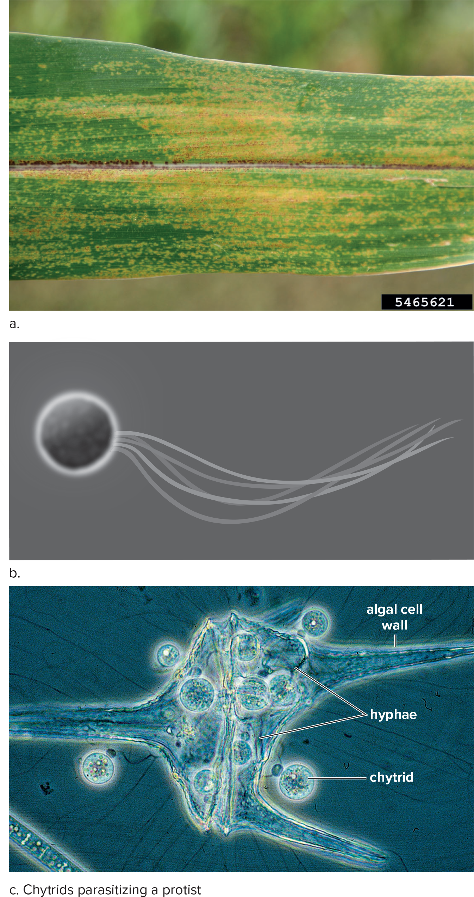
Fungal Phyla with Zoospores
Figure 22.4
(a): Daren Mueller/Iowa State University/Bugwood.org; (c): ©Reproduced with permission of the Freshwater Biological Association on behalf of The Estate of Dr Hilda Canter-Lund. ©The Freshwater Biological Association.

Slide 22
Zygomycota Produce Zygospores
Phylum Zygomycota is not monophyletic, and many of the relationships within this group have yet to be resolved
Zygospore fungi live off plant and animal remains in the soil or in bakery goods in the pantry
  Some are parasites of soil protists, worms, and insects such as the housefly

Slide 23
Rhizopus stolonifer
Rhizopus stolonifera is also known as the black bread mold
Rhizopus has both a sexual and an asexual phase in its life cycle
The body of this fungus is composed of mostly aseptate hyphae that can specialize to perform various tasks
  Rhizopus exhibits three kinds of specialized hyphae:
    Stolons: horizontal hyphae that exist on the surface of the bread
    Rhizoids: hyphae that grow into bread, anchor the mycelium, and carry out digestion
    Sporangiophores: aerial hyphae that bear sporangia
      Sporangium is a capsule that produces haploid spores, called sporangiospores, during the asexual phase of reproduction

Slide 24
Zygospores
Zygospores are diploid spores produced during sexual reproduction
Two mating types of hyphae, termed plus (+) and minus (−), are chemically attracted to one another, and they grow toward each other until they touch
  Hyphae then form gametangium that merge, and the nuclei fuse to form a diploid zygote
    A thick wall develops around the zygote, which is now called a zygospore
      Zygospore undergoes a period of dormancy before new haploid sporangiospores are formed by meiosis
      Sporangiophores with sporangia at their tips germinate from the zygospore, and many sporangiospores are released and dispersed by air currents

Slide 25
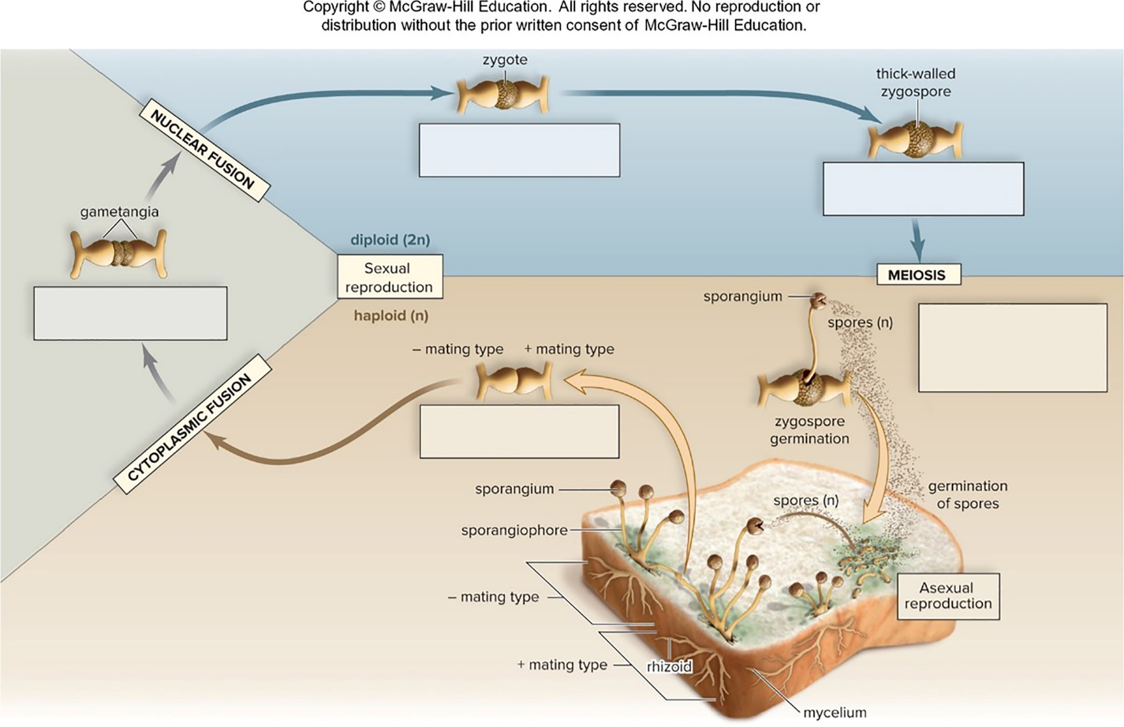
Black Bread Mold, Rhizopus stolonifer
Figure 22.5
Access the text alternative for slide images.

Slide 26
Glomeromycota Includes Important Symbiotic Fungi
Arbuscular mycorrhizal (AM) fungi are a relatively small group of about 230 species
  Arbuscules are branching invaginations that the fungus makes when it invades plant roots
  Mycorrhizae are a mutualistic association of plants and fungi
    They play a critical role in the ability of plants to absorb nutrients with their roots
    Majority of plants have a mutually beneficial relationship, or symbiosis, with AM fungi

Slide 27
Ascomycetes Produce a Fruiting Body Called an Ascocarp
Members of the Ascomycota phylum are called sac fungi
  Phylum includes 64,000 species can reproduce asexually or sexually
  Multicellular molds and single-celled yeasts are the most common morphological types
  Sac fungi play an essential ecological role in recycling by digesting materials that do not easily decompose, such as cellulose, lignin, and collagen
    Members of this phylum are also ecologically important, due to their relationships with plants, algae, and some animals
  Members of this phylum also have an important economic role
    Some species, mainly yeasts, are used to produce foods, while others cause food spoilage and can produce toxins
    Fungal infections are of medical importance, as is the production of antibiotics from sac fungi

Slide 28
Reproduction
Asexual reproduction is most common among these fungi
  Yeasts usually reproduce by asexual budding, in which a small cell forms and pinches off as it grows to full size
  Molds tend to produce spores called conidia, or conidiospores that are dispersed by wind
Sexual reproduction takes place in a fruiting body
  A fruiting body is a structure that is formed to produce and enhance the release of spores
    Sexual spores develop in an ascus, a fingerlike sac that develops during sexual reproduction
    Asci are found within a fruiting body called an ascocarp
    Within the ascus the hyphae are dikaryotic
      Two nuclei fuse to create diploid cells that in turn undergo meiosis to become new haploid cells called ascospores
      Ascospores are released and dispersed by the wind after bursting from a swollen ascus.

Slide 29
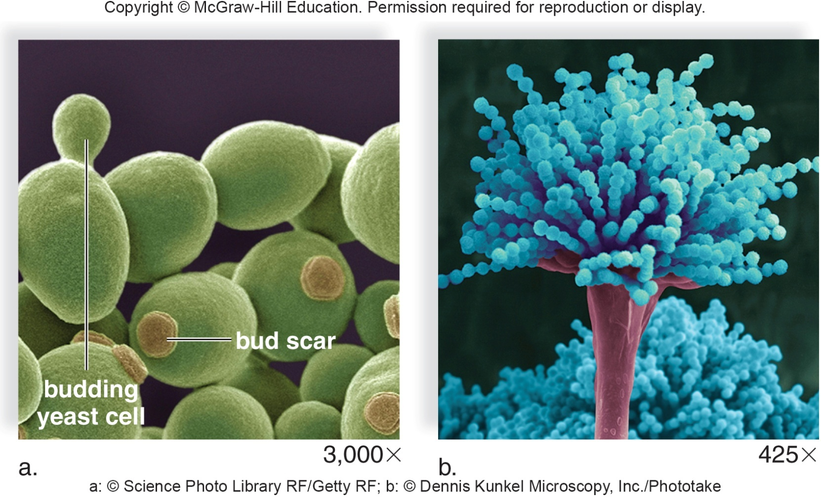
Asexual Reproduction in Sac Fungi
Figure 22.6
(a): Science Photo/Library/Getty Images; (b): Dennis Kunkel Microscopy, Inc./Diomedia

Slide 30
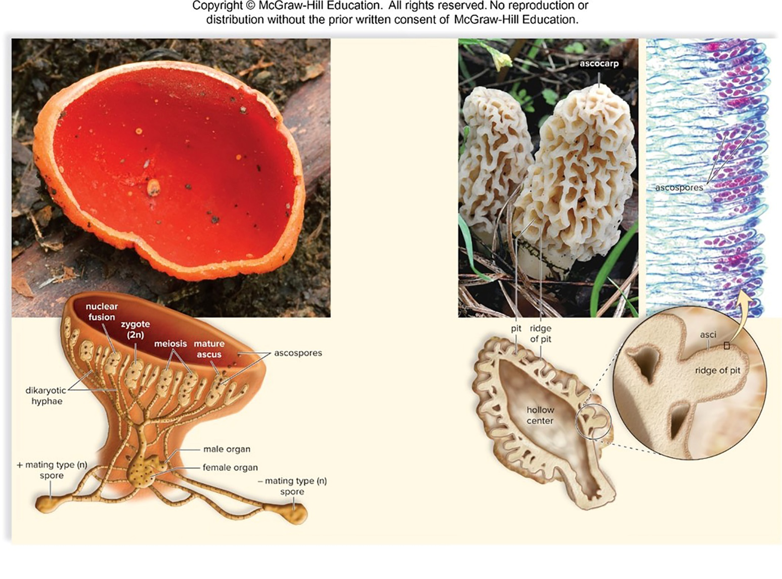
Sexual Reproduction in Sac Fungi
Figure 22.7
Access the text alternative for slide images.
(photos): (a): Carol Wolfe; (b, morel ascocarp): Bear Dancer Studios/Mark Dierker; (b, ascospores): Carolina Biological Supply/Diomedia

Slide 31
Food Industry
Yeast Saccharomyces cerevisiae is widely used in the baking and brewing industries
  Through the process of fermentation, yeast can produce ethanol and carbon dioxide gas
  Bread rises because of the gas given off during baking
  Beer, wine, and liquor obtain their alcohol by fermenting yeast
  Genus Aspergillus are molds used to produce soy sauce and the Japanese food miso by fermentation of soybeans
  Cheese industry uses the mold Penicillium to make blue cheese, Roquefort, Camembert, Brie, and Stilton
  Molds can also be detrimental to the food industry because they accelerate spoilage and can release toxins on food like peanuts and grains

Slide 32
Importance for Humans
Yeasts can be harmful to humans
  Candida albicans is a yeast that is normally found on the body
    When the balance of Candida and other microorganisms is disturbed, yeast proliferates, causing oral thrush in newborns or vaginal infections in women
    Moldlike fungi cause infections of the skin called tineas
      Athlete’s foot, jock itch, and ringworm are all tineas characterized by itching, peeling skin, or a raised inflammation
      Patients with AIDS or other immunocompromised conditions are particularly susceptible to fungal infections
      The strong similarities between fungal and human cells make it difficult to design fungal medications that do not harm patients
    Many sac fungi have antibiotic and antimicrobial properties
      Certain members of genus Penicillium produce antibiotic penicillin, which is a treatment for bacterial infections; another produces cyclosporine, which controls the immune system to prevent organ rejection after a transplant
    Many geneticists use ascomycetes as model organisms

Slide 33
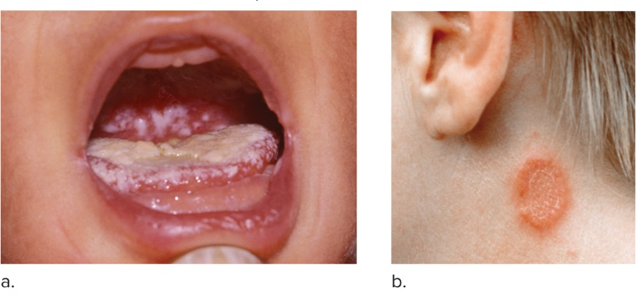
Fungal Infections
Figure 22.8
(a): Dr. M. A. Ansary/Science Source; (b): John Hadfield/SPL/Science Source

Slide 34
Basidiomycetes Produce a Fruiting Body Called a Basidiocarp
The phylum Basidiomycota, or club fungi, consists of over 31,000 species
  Phylum includes mushrooms, toadstools, puffballs, shelf fungi, jelly fungi, bird’s-nest fungi, and stinkhorns are basidiomycetes
  Includes plant diseases, such as smuts and rusts
  Approximately 75 species of basidiomycetes are considered poisonous

Slide 35
The Biology of Club Fungi
The mycelium is composed of septate hyphae
Most members of this phylum are saprotrophs, feeding on dead and decaying organic matter
They usually reproduce sexually
  Basidiomycota, refers to the basidium, a club-shaped structure which produces spores called basidiospores
  Basidia are located within a fruiting body called a basidiocarp, which we recognize as a mushroom

Slide 36
Mushrooms
Mushrooms are composed of tightly packed hyphae whose walled-off ends become basidia
  In gilled mushrooms, the basidia are located on folds called gills
  In shelf fungi and pore mushrooms the basidia terminate in tubes
  Basidiocarp is lined by basidia, where nuclear fusion, meiosis, and spore production occur
    Basidiospores are windblown
    It is estimated that some large mushrooms can produce up to 40 million spores per hour

Slide 37
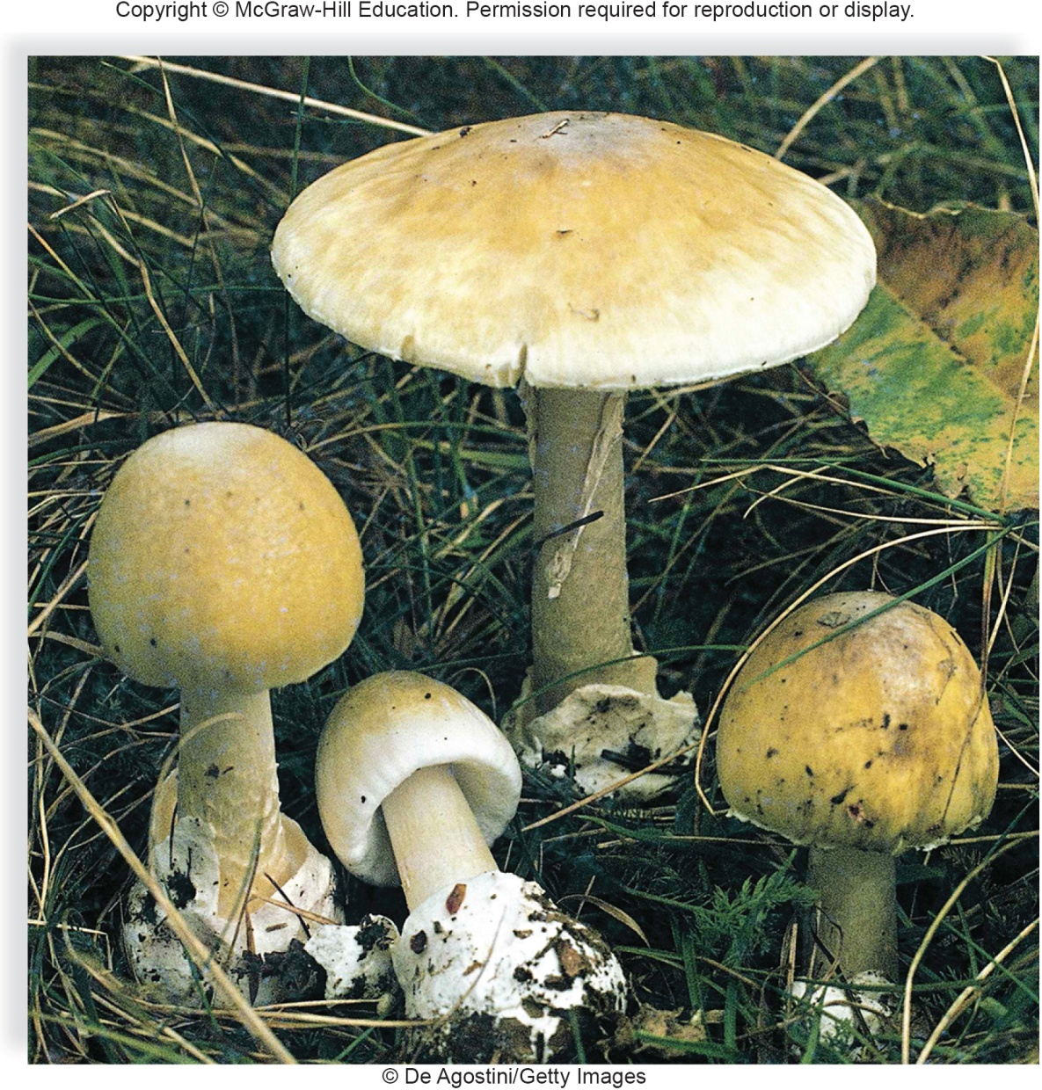
A Poisonous Mushroom, Amanita phalloides
Figure 22A
De Agostini/Getty Images

Slide 38
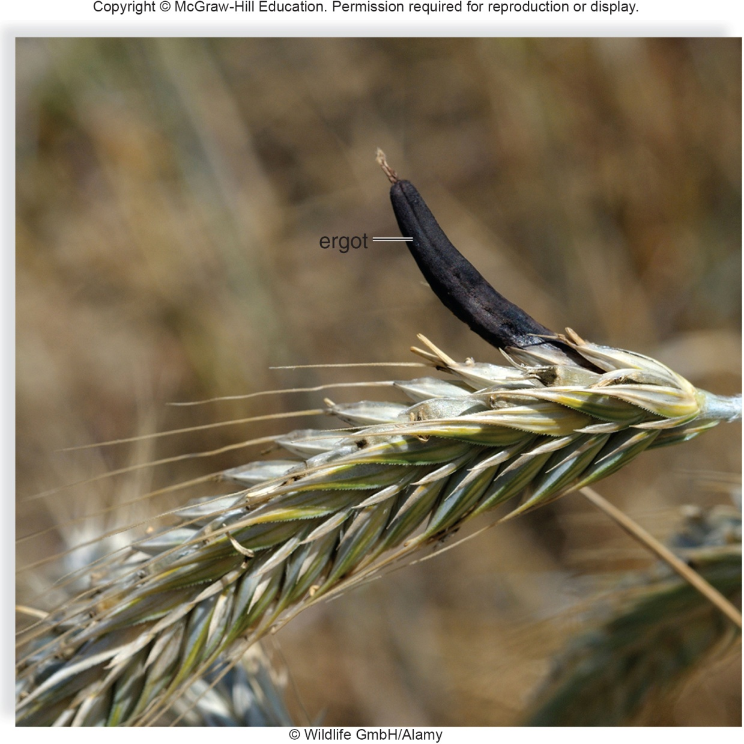
Ergot Infection of Rye, Caused by Claviceps purpurea
Figure 22B
Wildlife GmbH/Alamy Stock Photo

Slide 39
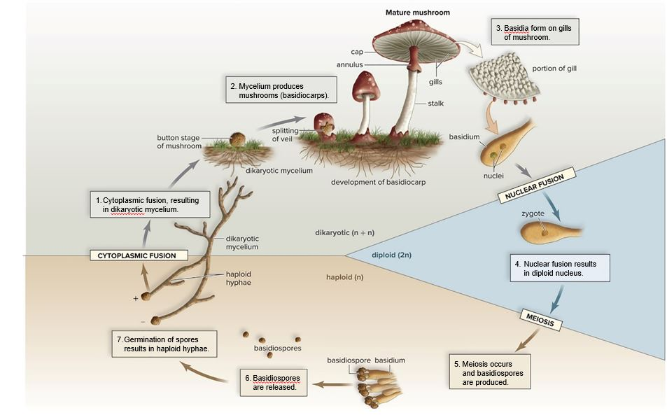
Life Cycle of a Typical Mushroom
Figure 22.9
Access the text alternative for slide images.

Slide 40
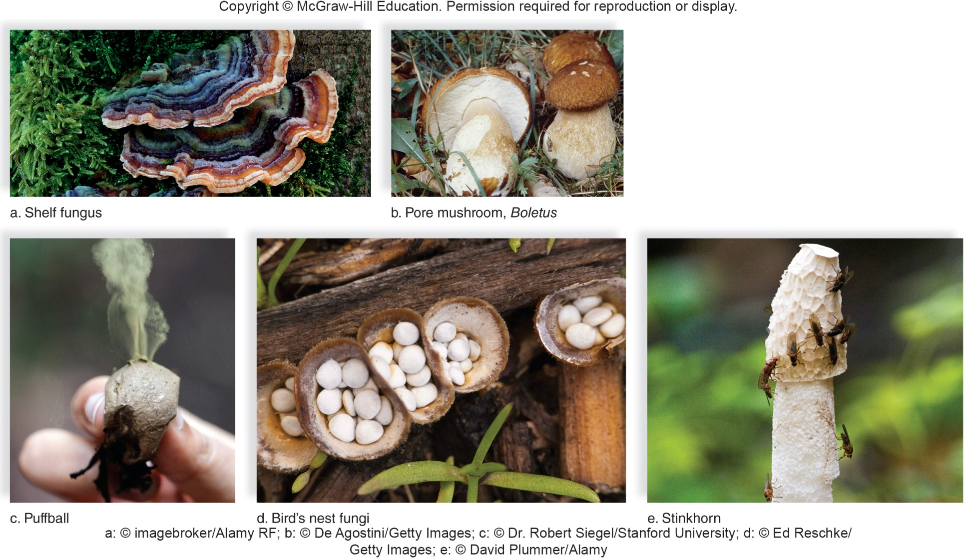
Club Fungi
Figure 22.10
(a): Alexander von Duren/imagebroker/Alamy Stock Photo; (b): De Agostini/Getty Images; (c): Dr. Robert Siegel/Stanford University; (d): Ed Reschke/Getty Images; (e): David Plummer/Alamy Stock Photo

Slide 41
22.3 Symbiotic Relationships of Fungi
Symbiosis is a close association between two different species
  Sometimes the association is mutualistic
    Beneficial to both species
      Examples are lichens and mycorrhizae
  A symbiosis can be parasitic
    Relationship benefits one partner, while the other partner is harmed
    Fungi are able to parasitize plants, animals, and even other fungi

Slide 42
Fungal Parasitism: Infections in Plants
Many fungal parasites of plants exist
  The ascomycete, Ophiostoma, wiped out elm trees in the United States by causing Dutch elm disease
  Physoderma maydis is a corn parasite
  Smuts and rusts are basidiomycetes that parasitize cereal crops, such as corn, wheat, oats, and rye
    They are of great economic importance because of the crop losses they cause every year

Slide 43
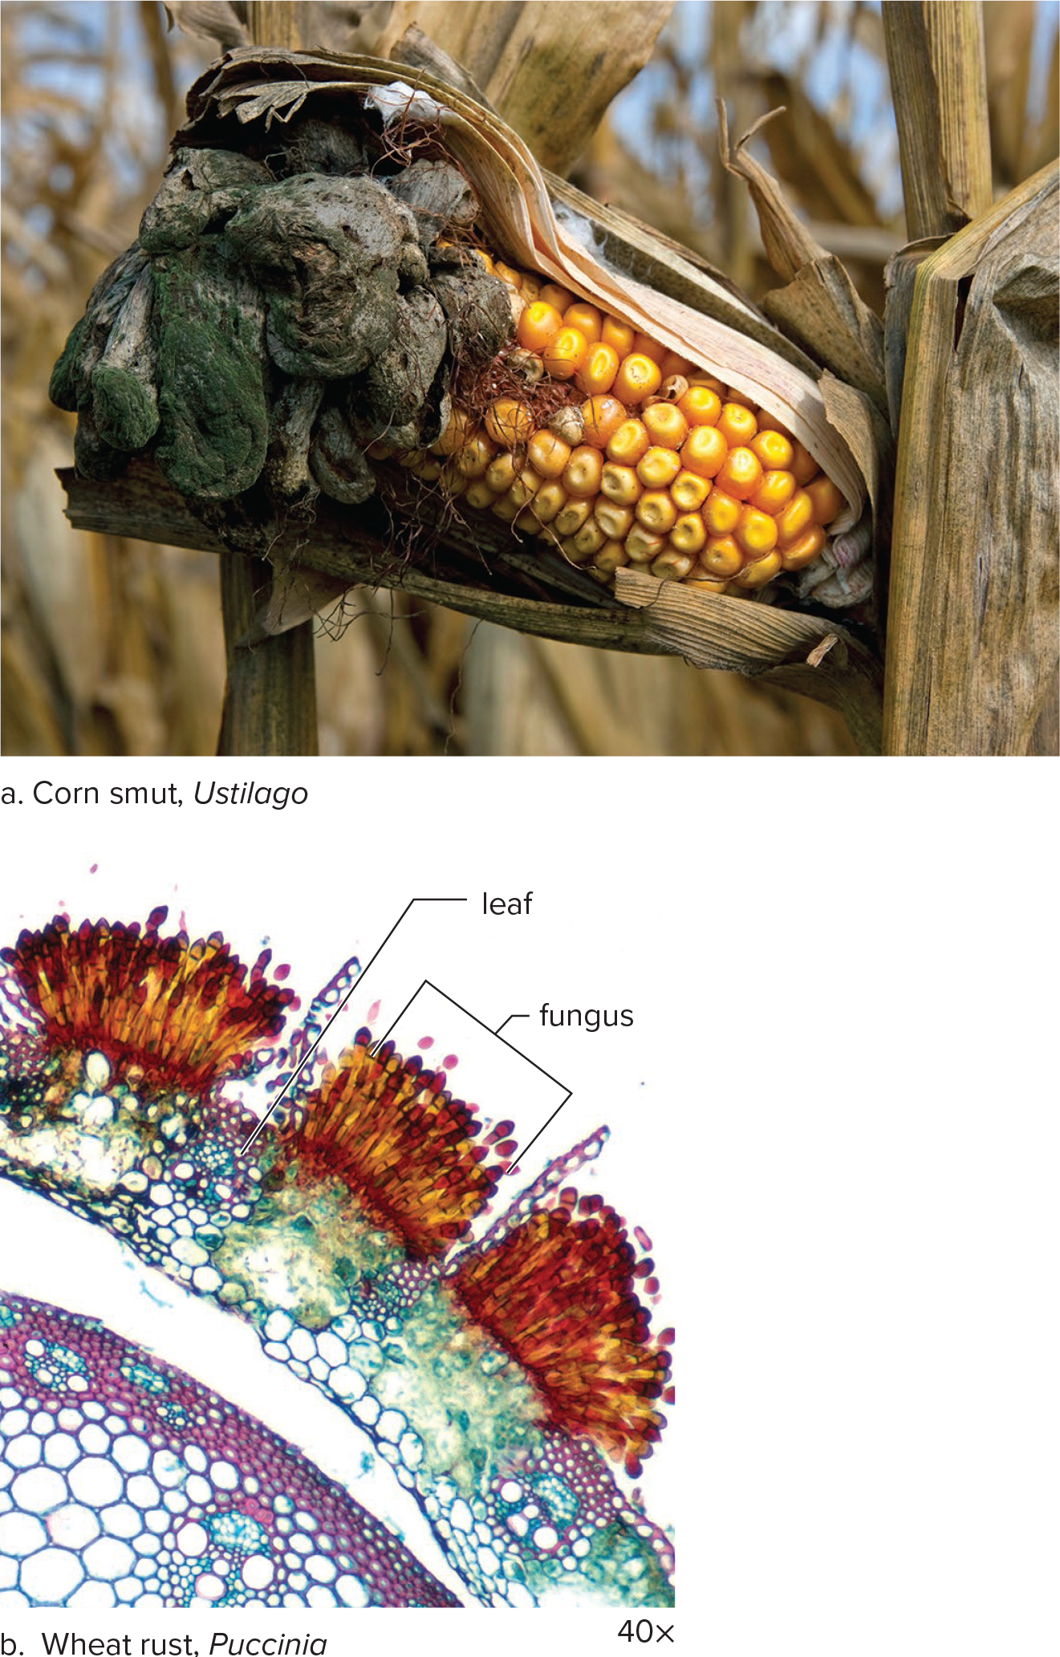
Smuts and Rusts
Figure 22.11
(a): Carol Dembinsky/Dembinsky Photo Associates/Alamy Stock Photo; (b): Patrick Lynch/Science Source

Slide 44
Infections in Animals
Invertebrates and vertebrates can be parasitized by fungi
  Hyphae traps can catch nematodes and digest them while still alive
  Insect exoskeletons can be penetrated by germinating spores that eventually take over their bodies
  Vertebrates, such as reptiles, can be attacked by molds, and amphibian populations are declining worldwide because of chytrid infections
  Fungal infection has decimated bat populations mainly along East Coast of United States and Canada
    Ascomycete called Pseudogymnoascus destructans is responsible for white nose syndrome
      Characterized by white fungus growing on infected bats’ muzzles
      Infection disturbs hibernating bats by waking them up during the winter months, causing them to look for food and starve to death

Slide 45
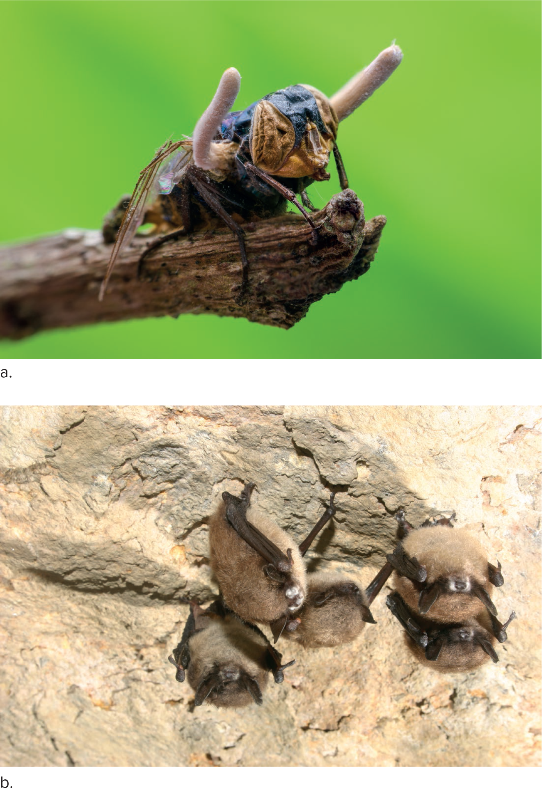
Animal Parasites
Figure 22.12
(a): khlungcenter/Shutterstock; (b): Source: Al Hicks/New York Department of Environmental Conservation/USGS

Slide 46
Lichens: Mutualistic or Parasitic?
Lichens are an association between fungi and a photosynthesizing partner
  Partner can be either a cyanobacterium or green alga
  Until recently, all lichens were thought to include only two organisms
    Current research shows that some lichens actually contain three partners: a photosynthesizing partner, one ascomycete and one basidiomycete

Slide 47
Lichens
In the past, lichens were assumed to be mutualistic relationships where
  Fungal partner(s) received nutrients from the algal cells
  Algal cells were protected from desiccation by the fungi
Lichens may involve a controlled form of parasitism of the algal cells by the fungi
  Algae do not benefit from the relationship

Slide 48
Lichen Shape and Environment
Three types of lichens are recognized by shape:
  Compact crustose lichens are often seen on bare rocks or tree bark
  Fruticose lichens are shrublike
  Foliose lichens are leaflike
Lichens are efficient at acquiring nutrients and moisture
  They can survive in areas of low moisture and low temperature
  They can survive in areas with poor or no soil
  They produce and improve the soil, thus making it suitable for plants
  Lichens cannot survive where the air is polluted

Slide 49
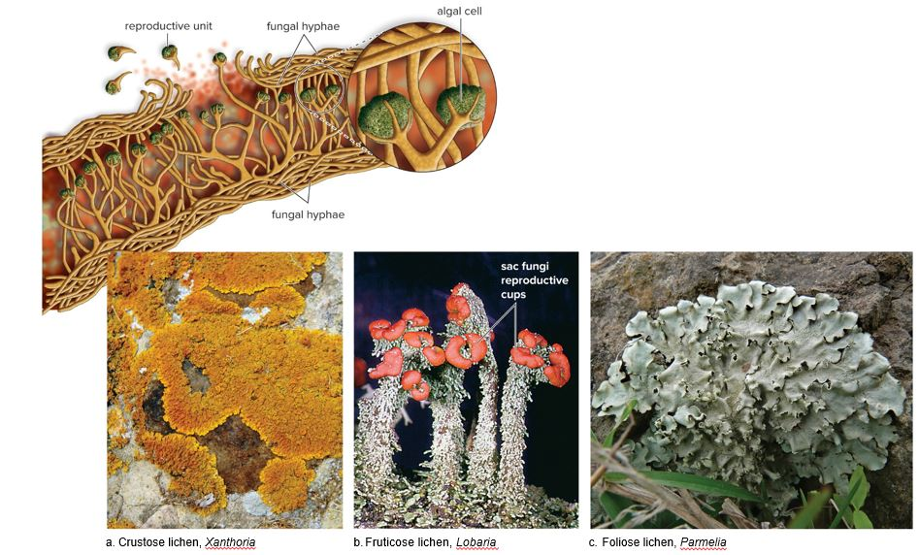
Lichen Morphology
Figure 22.13
Access the text alternative for slide images.
(a): Dr. Jeremy Burgess/Science Source; (b): Steven P. Lynch; (c): yogesh more/Alamy Stock Photo

Slide 50
Mycorrhizae: Mutualistic for Both Plant and Fungal Partners
Mycorrhizae are mutualistic relationships between soil fungi and the roots of most plants
  Plants whose roots are invaded by mycorrhizae grow more successfully in poor soils
    Mycorrhizae help plants obtain nutrients like phosphate from the soil
  Fungal partner is either a glomeromycete or a sac fungus
    Ectomycorrhizae form a mantle that is exterior to the root, and they grow between cell walls
    Endomycorrhizae penetrate only the cell walls
      Presence of the fungus gives the plant a greater absorptive surface for the intake of minerals
        Fungus benefits from the association by receiving carbohydrates from the plant

Slide 51
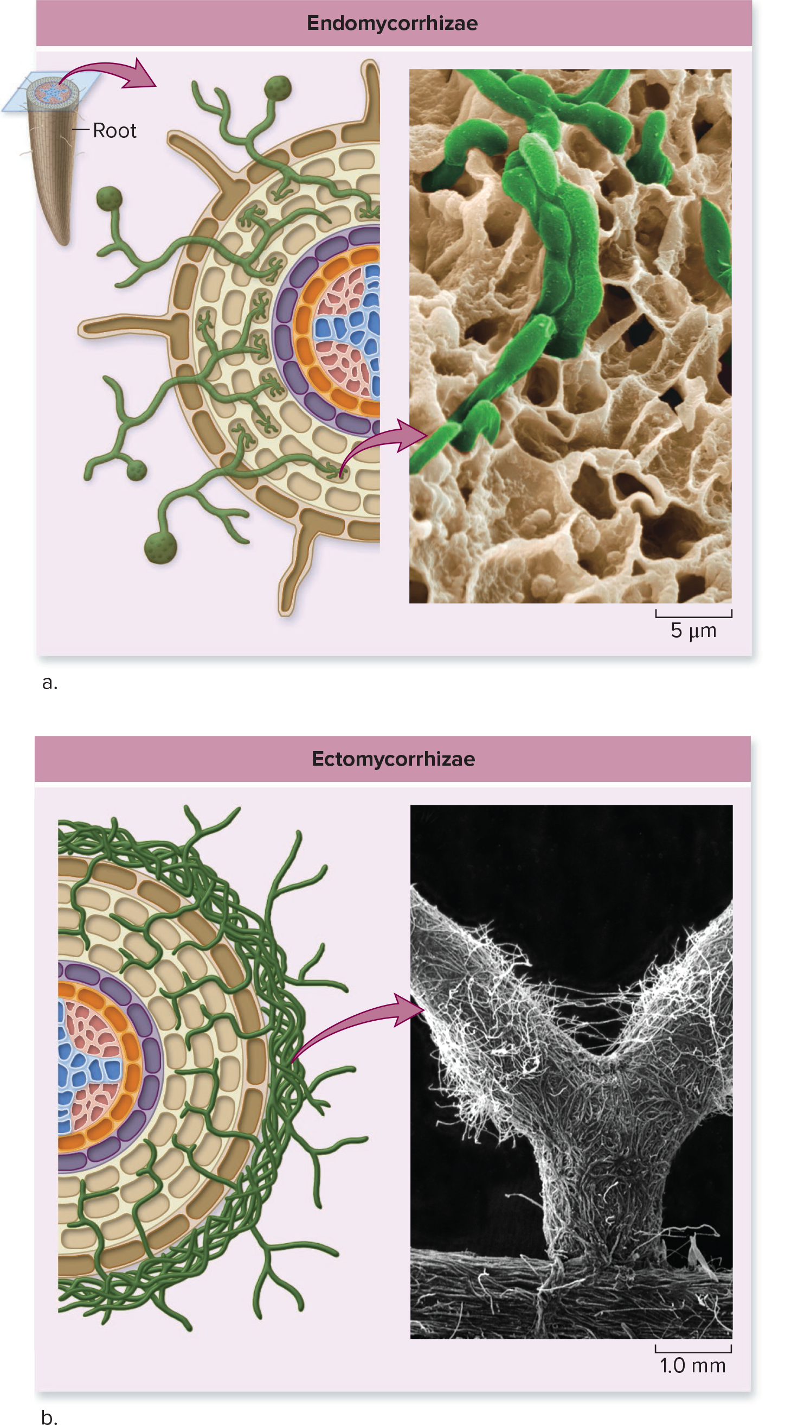
Endomycorrhizae and Ectomychorrhizae
Figure 22.14
Access the text alternative for slide images.
(a): Eye of Science/Science Source; (b): H.B. Massicotte, R.L. Peterson and L.H. Melville

Slide 52
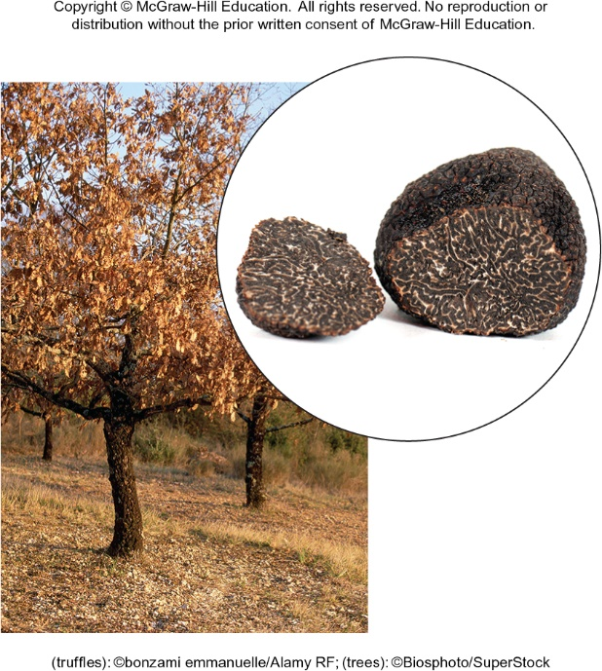
A Black Truffle
Figure 22.15
(truffles): Biosphoto/SuperStock; (trees): bonzami Emmanuelle/Alamy Stock Photo

Slide 53
End of main content
Copyright 2022 © McGraw Hill LLC. All rights reserved. No reproduction or distribution without the prior written consent of McGraw Hill LLC.

Slide 54
Accessibility Content: Text Alternatives for Images

Slide 55
Evolutionary Relationships Among the Fungi - Text Alternative
Return to parent-slide containing images.
Common eukaryotic ancestor branches into excavata species as: diplomonads, parabasalids and euglenozoans.
Common eukaryotic ancestor branches into chromalveolata species as: dinoflagellates, apicomplexans and ciliates (through alveolates) and diatoms, golden algae, brown algae and Oomycetes (through stramenopiles).
Common eukaryotic ancestor branches into rhizaria species as: cercozoans, forams and Radiolarians.
Common eukaryotic ancestor branches into archaeplastida species as: red algae, chlorophytes (green algae) and land plants.
Common eukaryotic ancestor branches into amoebozo species as: amoebozoa.
Common eukaryotic ancestor branches into opisthokonta species as: fungi, choanoflagellates and animals.
Fungi species lead to blastocladiomycota, zygomycota, neocallimastigomycota and chytridiomycota, glomeromycota, basidiomycota and ascomycota.
Return to parent-slide containing images.

Slide 56
Black Bread Mold, Rhizopus stolonifer - Text Alternative
Return to parent-slide containing images.
1. Hyphae of opposite mating types touch.
2. Gametangia form at the end of each hypha.
3. Gametangia merge and nuclei pair, then fuse.
4. A thick wall develops around the cell.
5. Sporangiophores develop, and spores are released from sporangium.
Return to parent-slide containing images.

Slide 57
Sexual Reproduction in Sac Fungi - Text Alternative
Return to parent-slide containing images.
A) Ascocarp of the cup fungus, Sarcoscypha:
It shows ascospores and dikaryotic hyphae across the cup, with nuclear fusion, zygote (2n), meiosis, mature ascus, positive mating type (n) spore, male organ, female organ and negative mating type (n) spore.
Ascocarp of the morel, Arcshceolclar:
It shows pits and ridge of pit on the exterior with asci and hollow center.
Micrograph of asci shows multiple ovular ascospores.
Return to parent-slide containing images.

Slide 58
Life Cycle of a Typical Mushroom - Text Alternative
Return to parent-slide containing images.
Illustrates the following steps: 1.Cytoplasmic fusion, resulting in dikaryotic mycelium. 2. A mycelium forms to produce mushrooms (basidiocarps). 3. Basidia form on gills of mushroom. 4. Nuclear fusion results in diploid nucleus. 5. Meiosis occurs and basidiospores are produced. 6. Basidiospores are released. 7. Germination of spores results in haploid hyphae.
Return to parent-slide containing images.

Slide 59
Lichen Morphology - Text Alternative
Return to parent-slide containing images.
A) A cross-section of a compact crustose lichen shows labels for reproductive unit, fungal hyphae, and algal cell.
b. Microscopic view of Fruticose lichens shows label for sac fungi reproductive cups.
c. Foliose lichens are leaf like.
Return to parent-slide containing images.

Slide 60
Endomycorrhizae and Ectomychorrhizae - Text Alternative
Return to parent-slide containing images.
a. In endomycorrhizae, fungal hyphae penetrate the root cell wall.
b. In ectomycorrhizae, fungal hyphae grow around roots or between cells, but never penetrate the cells. Microscopic view on the right shows Y-shaped structure.
Return to parent-slide containing images.

